Slide 1
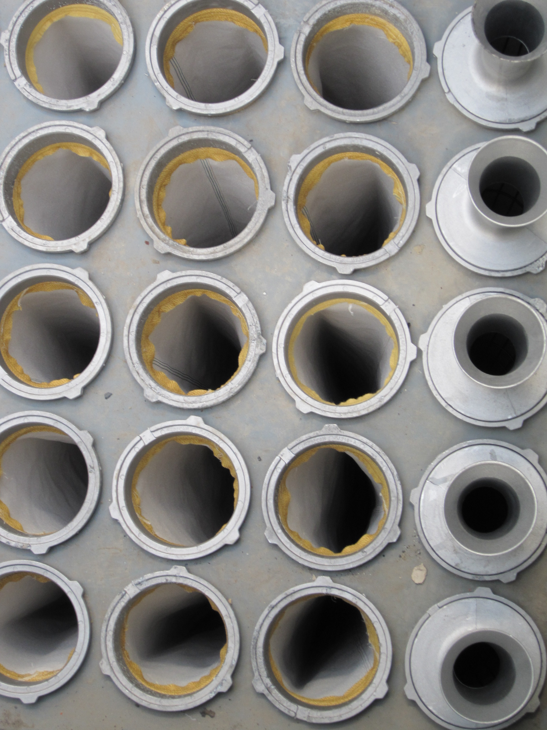
Introduction Dedusting
Technical Development Program for Process Performance Engineers – SPREAD 2016
Mirko Weber

Slide 2
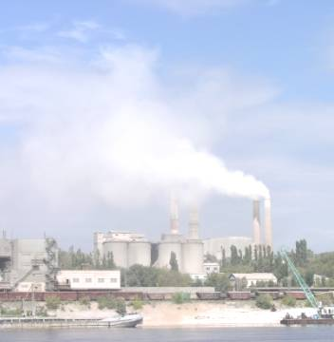
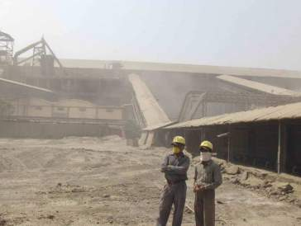
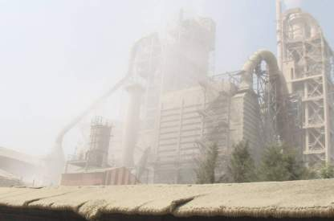
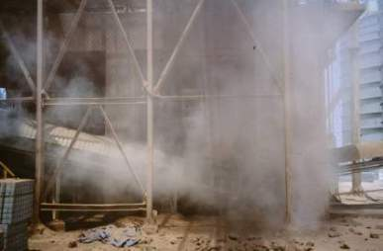
Why Dust Control ?
2

Slide 3
Why Dust Control ?
Reducing health hazard possibilities
Assuring compliance with existing regulations
Reducing cleanup and maintenance cost
Reducing equipment wear and downtime
Increasing visibility and reducing probability of accidents
Reducing troubles in community relation
More pleasant working condition thus improving employee morale and productivity
Possible product savings
3

Slide 4
Kiln/Raw Mill Filters - EP’s get less, however there is still a significant amount in LafargeHolcim
Legacy Holcim 2009: Around 50% EP‘s
Legacy Holcim 2012: Around 35% EP‘s
Total 185
Total 217
4

Slide 5
EP performance lower compared to BF
Source: PEP 2009
Around 20% above 50 mg/Nm³
Around 55% below 20 mg/Nm³
Total 144 reported
Almost all Bag Filters run below 20 mg/Nm³
Almost half of the EP’s run above 50 mg/Nm³
5

Slide 6
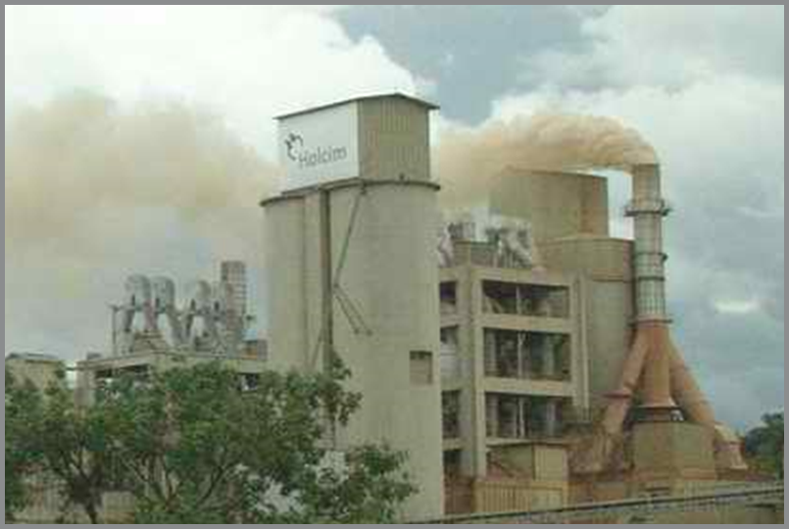
Cleaning efficiency of Electrostatic Precipitator depends on various parameters
Available collecting area
Moisture content in raw gas
Gas temperature
Gas velocity (False air!)
Dust content in raw gas
Dust properties (resistivity, particle size distribution)
Power input
Availability (CO peaks!)
6

Slide 7
Changed conditions can have an impact on EP performance
Change of fuel mix (more “difficult” fuel):
More CO peaks due to instable combustion (fuel feed, net calorific value – e.g.)
Higher gas flow rate (due to higher heat consumption or false air)
More Cl, SO₃, NH₃, organics can lower the EP performance
Transition phase during mill start with higher dust emission
higher temperature at EP inlet (gasflow/dew point)
EP inlet temperature
Dust Emission
95°C
time
Mill ON
7

Slide 8
Convert the EP to a Bagfilte?
Process dependence of EP while BF unaffected by process conditions within a wide range
Optimization potential EP: precipitation, gasflow, power → references show 50 mg/Nm3 or 20 mg/Nm3 possible with EP upgrade! → lower CAPEX compared to conversion
Disadvantage BF: delta P, waste (bags), temperature limited, potential selective dust collection only in EP
8

Slide 9
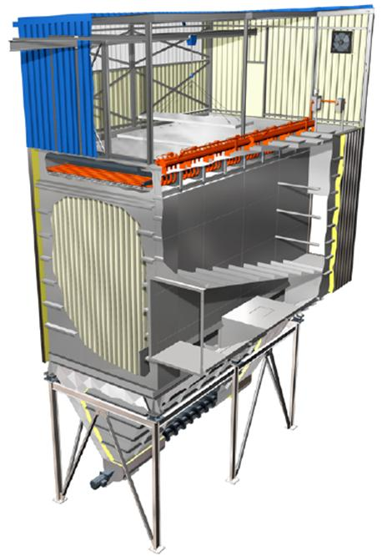
General Description of a “Pulse Jet” Bag Filter
Penthouse for regular maintenance
Clean gas and “Pulse Jet” cleaning injectors
Clean gas plenum
Collecting duct and filter outlet
Raw gas chambers with bags
Raw gas duct inlet to dedusting chambers
Hopper and conveyor for dust collection
Scheuch
9

Slide 10
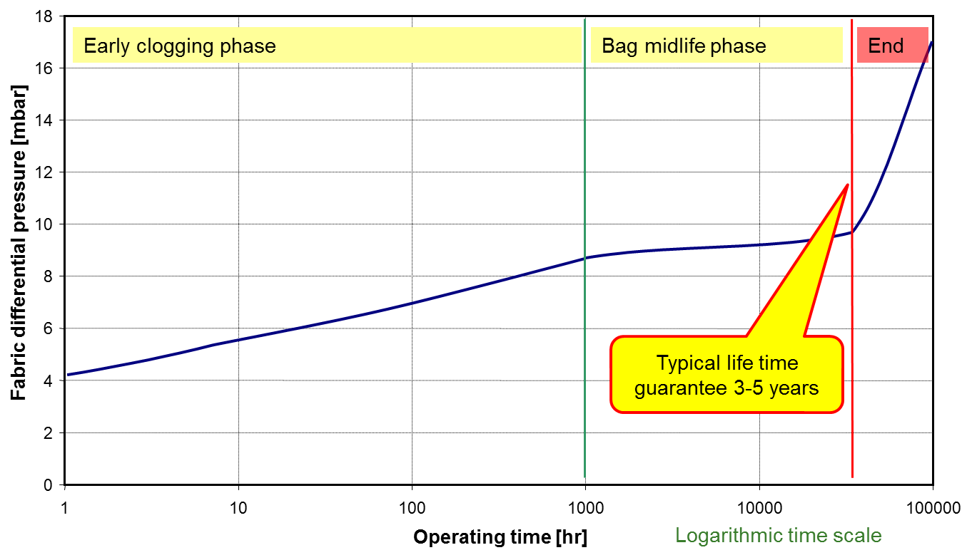
Pulse Jet Bag Filter Main Figures
Dust emission
<10-20 mg/Nm3 independent from process
No transient operation influence
No CO issue (no ignition source)
Bags
Length: 3.5 to 10 m
Air-to-Cloth: 1.0 m3/(min*m2)
Operating temperature
120°- 230°C max.
Pressure drop flange to flange
10 - 15 mbar
Compressed air for bags-cleaning
0.5 – 4 bar
Bag life time
4 years and more
10

Slide 11
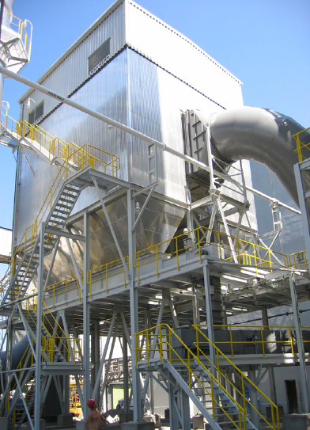
Case Study Typical Problems in a Bagfilter
Corrosion
High pressure drop
Dust emission
Short bag life time

